Slide 1
PV Module Reuse and Recycling in the R2 Standard September 16th, 2024 Champions of Electronics Sustainability

Slide 2
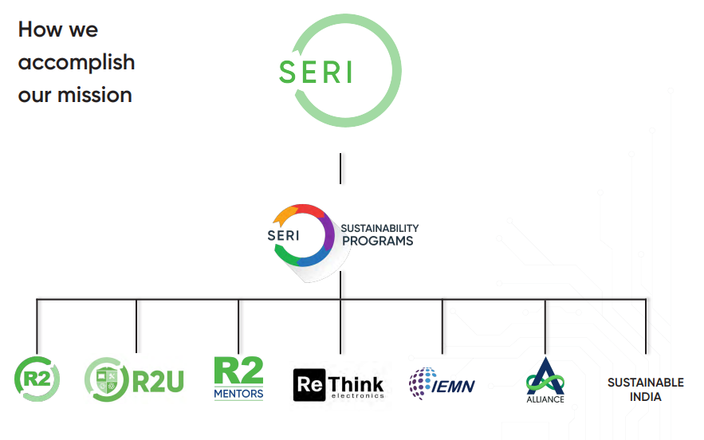
OVERVIEW OF SERI AND THE R2 STANDARD
SERI Purpose and Goals
Other SERI programs
Notes:
Mission:
Working to create a world where electronic products are reused and recycled in a way that results
in resource preservation, the well-being of the environment, and the health and safety of workers
and communities.

Slide 3
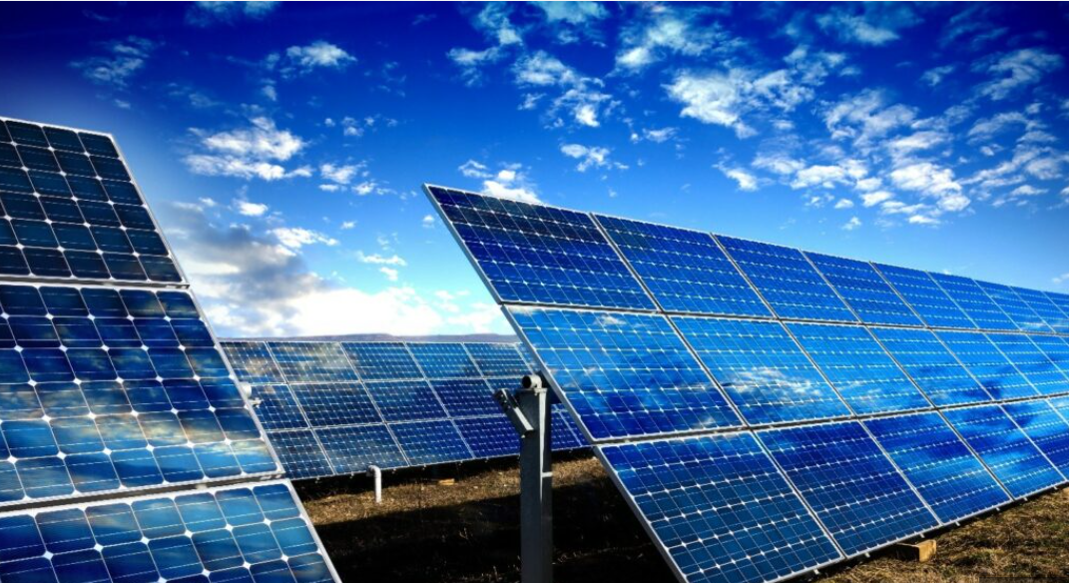
DRIVING TO ACHIEVE CIRCULARITY
Notes:
Transition to clean energy through solar panels is an important step in sustainability.
Need to ensure we close the loop on the management of solar panels to achieve the most out of this step towards sustainability.
It is still more cost effective in most global markets to landfill solar panels rather than pay for recycling.
But we need take a step back first and look at how we manage these panels.
Are the elective upgrades of huge utility scale solar farms being recycled?
Don’t these panels have a lot of useful life left in the panel?
How can set up the framework for proper reuse of panel before considering recycling?
If they are truly end of life, how do we set up the framework for proper recycling rather than landfilling?

Slide 4
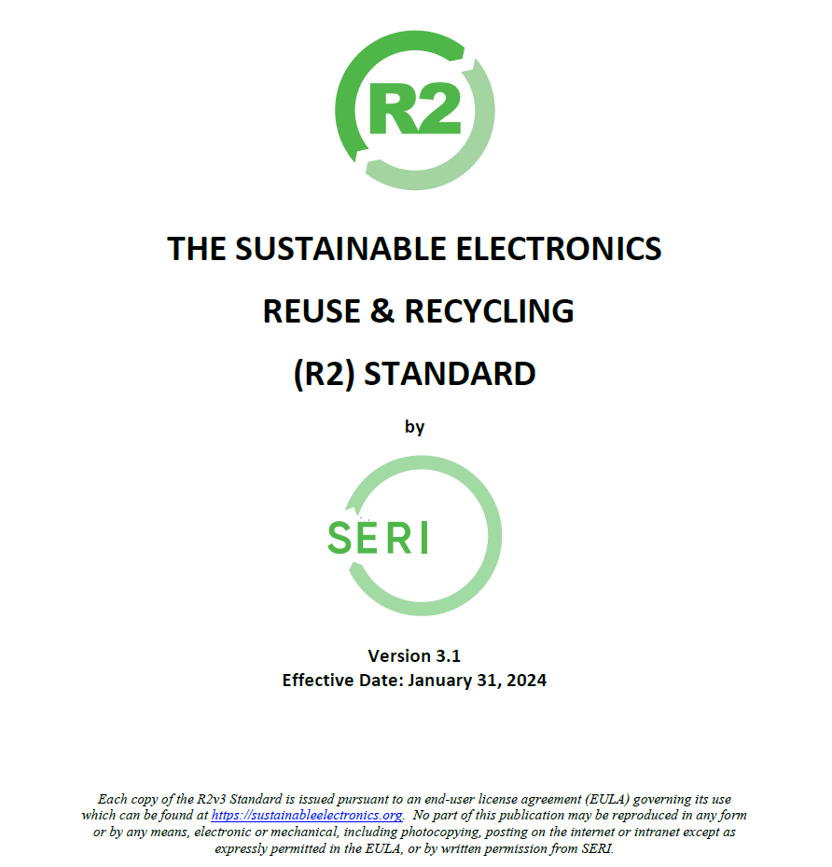
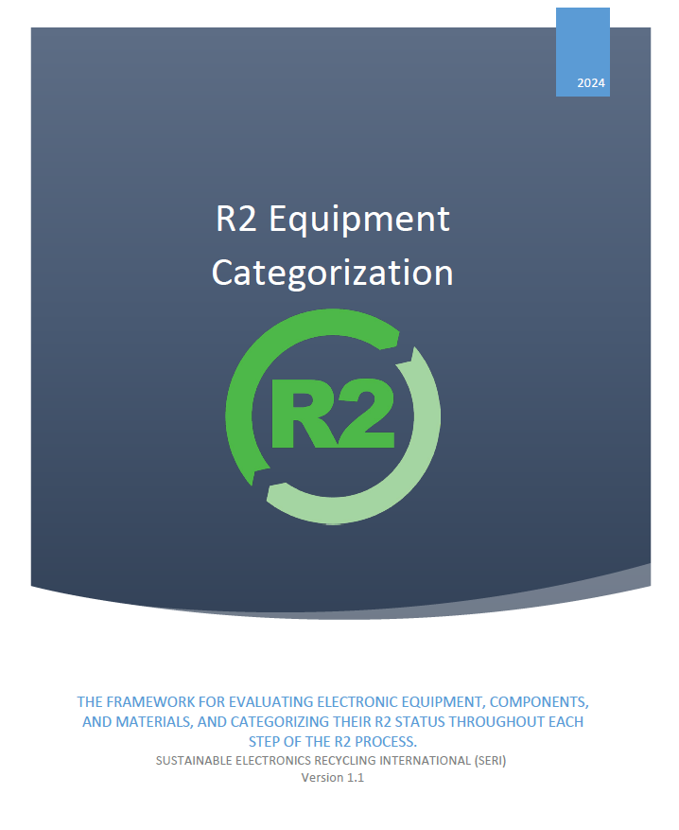
STANDARDS AS CATALYSTS FOR DRIVING CIRCULARITY
Notes:
SERI has added PV Modules to the R2 Standard to ensure people have a way to recognize legitimate reuse and recycling options for solar panels
Standards can drive sustainability at a systems level
The R2 Standard forces a circular approach requiring reuse before recycling, and recycling before disposal
R2 requires the proper recycling of hazardous materials within the solar cell
R2 implements an EHS Mgmt. system by also requiring certification to ISO 14001 and ISO 45001 (or RIOS)
R2 applies not just to the R2 Facility, but through the recycling chain
Certification creates the accountability
Independent auditing by accredited CBs –In India, NABCB the Accreditation Body has made a commitment to offering accreditation to R2, and a couple CBs are working on getting accredited to certify to the R2 –will cut of the costs of audits because it will be in the local currency.
Additionally, R2 has an additional layer of oversight in the SERI Assurance program –Our team in India has performed spot inspections on roughly 75% of the 54 R2 certified facilities in India
Commitment from stakeholders like corporations and governments drive adoption of standards and create change
Regulation can prefer or require R2 Certification to drive adoption –The E-Waste Rules of 2022 include PV Modules (Code CEEW14)
Corporation can prefer or require R2 for returns or elective upgrades of PV modules
These commitments drives adoption and adoption drive systems change

Slide 5
OVERVIEW OF THE R2 STANDARD AND SERI
R2 Standard Structure
Core Requirements (ALL R2 Facilities)
Process Requirements (Only those carrying out processes/activities covered by the Appendices)
Addition of Appendix G
Notes:
The R2 Standard establishes responsible reuse and recycling (“R2”) practices for the management and processing of used electronics globally. By certifying to this Standard through an accredited third-party Certification Body, an R2 Facility can help IT asset managers, sellers of used electronics, and prospective purchasers of IT Asset Disposition, refurbishment, remarketing, and recycling services (among others) make informed decisions and have increased confidence that used electronic equipment is managed in an environmentally responsible manner, protective of the health and safety of workers and the public, and that all data on all devices is secure and effectively destroyed.

Slide 6
THE R2 STANDARD CHANGE PROCESS
ANSI Accredited
ANSI process
1) notify ANSI,
2) Small group,
3) TAC proposed changes,
4) Con Body approve for public comment,
5) Public Comment, (repeat steps where significant changes are made to draft standard)
6) TAC review and address comments,
7) Con Body approve for SERI Board,
8) SERI board approve,
9) Publish.

Slide 7
INCLUSION OF PV MODULES IN R2V3
Why? History
PV panel recommendation small group (Oct 2020-Mar 2021) -5 meetings –to determine if R2 would work with PV modules reuse/recycling
TAC decides to adopt PV modules in the standard and add new TAC members from the PV Industry (May 2021)
ANSI notification -6/23/21 –Project need notification.

Slide 8
INCLUSION OF PV MODULES IN R2V3
TAC member additions (added 9 in Oct 2021):
Ed Mopas, SunPower Corp -Customer
Jan Clyncke, PV Cycler -Customer
Ricky Sinha, First Solar -Customer
Evelyn Butler, SEIA –Public Interest
Ron Vance, EPA –Public Interest
Garvin Heath, NREL –Public Interest
Tommy McGuire, Echo Environmental –R2 Facility
Dwight Clark, We Recycle Solar –R2 Facility
Sam Vanderhoof, Recycle PV Solar –R2 Facility

Slide 9
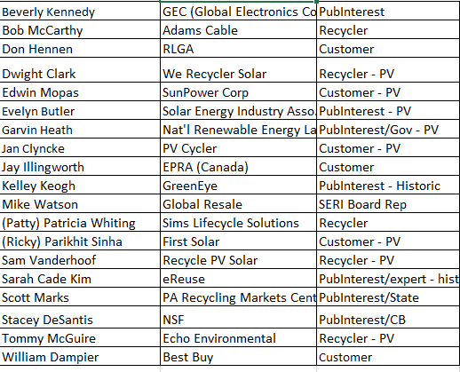
INCLUSION OF PV MODULES IN R2V3
TAC –PV Drafting Small Group (Jan 2022-Mar 2023) Members, 12 meetings

Slide 10
INCLUSION OF PV MODULES IN R2V3
Overview of Appendix G and other changes:
Appendix G
Make PV modules applicable to rest of R2
Process for evaluating hazards related to PV modules
Process for evaluating modules for reuse and recycling
Reuse and recycling and brokering requirements
R2 Equipment Categorization
Categorization of Functional PV Modules –assigned to those that required repair vs. those that were functional when tested
R2 Standard
Definitions –PV Modules and Solar Cells as a Focus Material

Slide 11
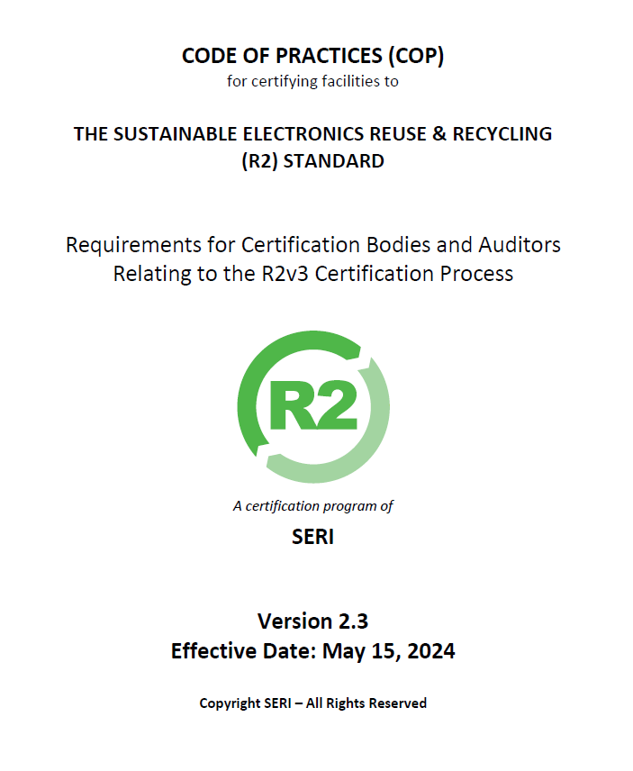
INCLUSION OF PV MODULES IN R2V3
Notes:
Auditor Training May 2024 on Appendix G
Publication of the new Code of Practices (COP) May 15th, 2024 with inclusion of audit time and transition rules for Appendix G
CBs accredited to R2 working to implement new COP
As early as August, facilities can start getting certified to Appendix G
Transition timeline -1/31/27

Slide 12
INCLUSION OF PV MODULES IN R2V3
Download the addition of PV modules into the R2 Standard along with the R2 Equipment Categorization (REC) guide here:
https://sustainableelectronics.org/welcome-to-r2v3/document-library/

Slide 13
Thank you!

